Slide 1

Welcome to your webinar!
Please ensure you are connected to Audio. You can re-connect at any time using the “Connect to Audio” or “Change Audio Connection” option at the bottom of the screen.​
You have been muted to prevent background noise from being disruptive. A Q&A session will take place at the end of the Webinar.
If you would like to ask a question/make a comment while muted, please use “Chat”. If you choose to send to “Everyone”, your name and comment will be visible to all attendees. If you would like your name to be confidential, please ensure to send to “Trainer Name (Host, presenter)”.
The Optum EWS information in this training is only applicable to the eligible members in attendance.

Slide 2

Preventing Burnout

Slide 3

Learning points
1
Identify what causes burnout
2
Examine facts and fiction surrounding burnout
3
Make a personal plan to reduce burnout

Slide 4

What is Burnout?

Slide 5

How do you define burnout?

Slide 6

Burnout defined
Burnout is a syndrome conceptualized as resulting from chronic workplace stress that has not been successfully managed.
Feelings of energy depletion or exhaustion
Increased negative feelings about one’s job
Reduced professional efficacy

Slide 7



Signs and symptoms of burnout
Physical signs
Emotional signs
Behavioral signs

Slide 8


Stress versus burnout
Stress = too much
Burnout = not enough

Slide 9
What Causes Burnout?

Slide 10
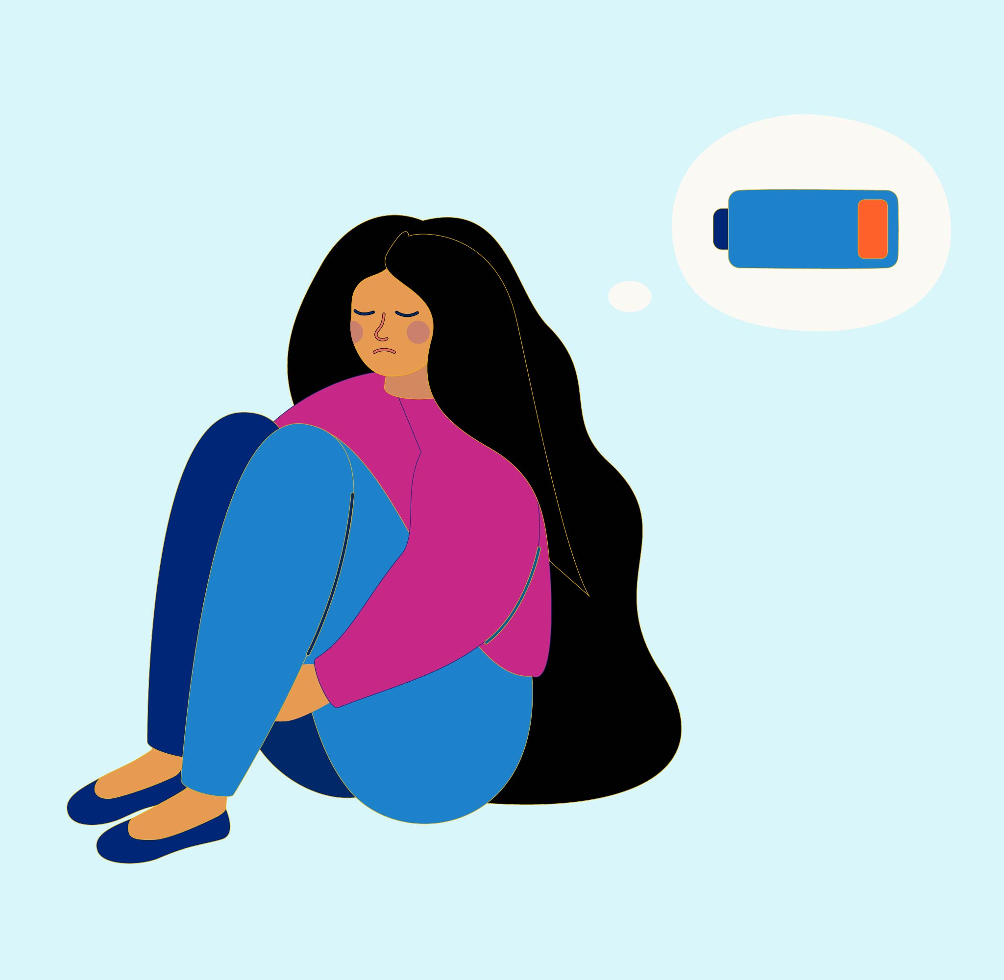
What do you think causes burnout?

Slide 11



Causes of burnout
Being overworked
Recognition
Relationships

Slide 12



Causes of burnout
Expectations
Fairness
Values

Slide 13
Burnout – Fact or Fiction

Slide 14


Fact or fiction
Burnout is associated with a lot of health risks.
People who feel burned out are weak and just can’t handle stress.
Fact
Fiction
Fact
Fiction

Slide 15


Fact or fiction
Burnout is a personal issue – not an organizational issue.
Working less is one of the best ways to combat burnout.
Fact
Fiction
Fact
Fiction

Slide 16


Fact or fiction
Making time for self-care is important.
More sleep and time off will solve burnout.
Fact
Fiction
Fact
Fiction

Slide 17


Fact or fiction
A big life change isn’t necessary to get rid of burnout.
Once you “get over it” burnout won’t come back.
Fact
Fiction
Fact
Fiction

Slide 18
Tips to Reduce Burnout

Slide 19
The Three R Approach
Recognize – look out for early indicators of burnout
Recognize
Reverse – repair the harm by getting help and controlling stress
Resilience
Reverse
Resilience – maintain physical and mental wellbeing to become more resistant to stress

Slide 20

Turn to other people
Build a strong social circle
Talk to people you trust
Talk to a therapist

Slide 21

Reframe the way you look at work
Find value in your work
Find balance in your life
Make friends at work
Take time off

Slide 22

Reevaluate your priorities
Set boundaries
Establish a daily routine
Nourish your creative side
Set aside relaxation time
Take a daily break from technology
Get plenty of sleep

Slide 23

Make exercise a priority

Slide 24

Support your mood and energy with a healthy diet
Minimize sugar and refined carbs
Minimize foods that can impact mood
Increase omega-3 fatty acids
Avoid nicotine
Consume alcohol in moderation

Slide 25

Mindfulness
Practice self-compassion
Pay attention to your needs
Remember what makes you happy
Care for your mental health
Practice mindfulness

Slide 26
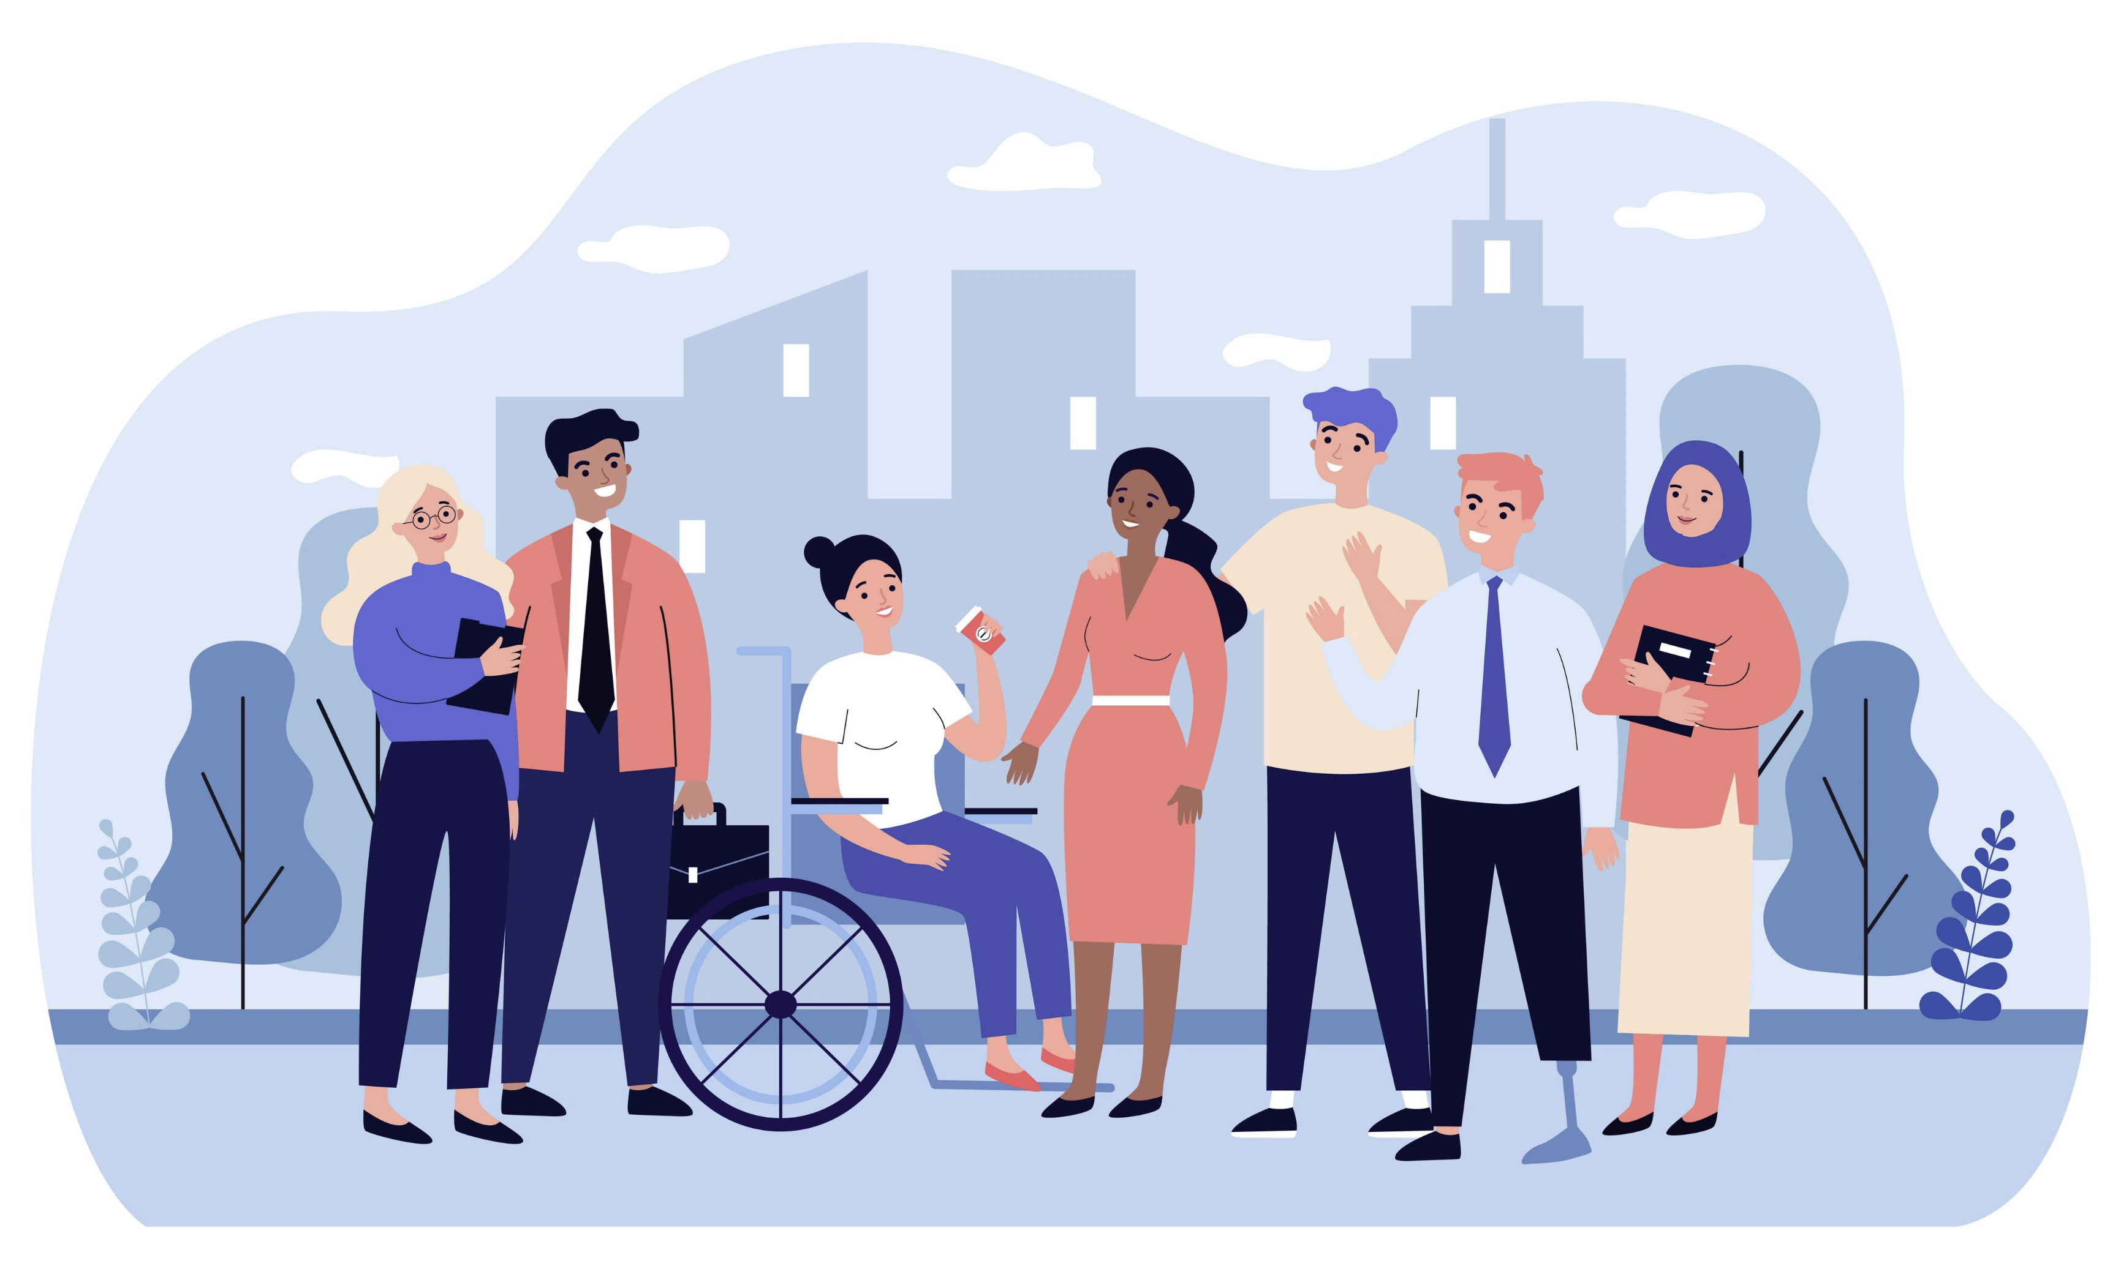


Emotional Wellbeing Solutions (EWS)
More than your traditional employee assistance program (EAP)
Free counselling and support for all employees and eligible family members.
Easily accessible, voluntary and confidential in accordance with the law.
A service that can provide support for personal or work-related issues.​
Staffed by experienced professionals.
“This program should not be used for emergency or urgent care needs. In an emergency, call the phone number of the local emergency services, or go to the nearest accident and emergency department. This program is not a substitute for a doctor’s or professional’s care. Due to the potential for a conflict of interest, legal consultation will not be provided on issues that may involve legal action against Optum or its affiliates, or any entity via which the caller is receiving these services directly (e.g. employer). This program and its components may not be available in all locations or for all group sizes and is subject to change. Coverage exclusions and limitations may apply. The Optum EWS information in this training is only applicable to the eligible members in attendance.”

Slide 27

About professional support
Consider seeking professional support if you experience any of the following:
Sleep problems
Excessive anxiety or worrying more than normal
Performance issues at work
Feeling overwhelmed or sad for more than two weeks
Relationship difficulties with family or friends
A noticeable change in appetite, eating too little or too much
Loss of interest in hobbies you normally enjoy
Behavior and coping methods have become harmful to yourself or others, whether that is through aggressive behavior or unhealthy habits, such as alcohol or drug misuse
Lack of caring about normal everyday work tasks
Thoughts of harm to self and/or others*
Keep in mind some of these conditions warrant more urgent professional help.
*If you or someone you know have thoughts about suicide or are in crisis, seek help right away. If you or someone you know is in immediate danger, call 911 — or go to the closest emergency room.

Slide 28
Q&A

Slide 30
References
Dates Booth, J. (9 September 2020). 17 facts about burnout you need to know. Redbook. https://www.redbookmag.com/life/g32072571/facts-about-burnout/. Accessed 25 March 2024.
Burnout. (n.d.) Psychology Today. https://www.psychologytoday.com/us/basics/burnout?. Accessed 21 March 2024.
Clinic, C. (19 March 2024). What is burnout? Cleveland Clinic. https://health.clevelandclinic.org/signs-of-burnout. Accessed 28 March 2024.
Limeade. (10 June 2022). Debunking the five most common burnout myths. https://www.limeade.com/resources/resource-center/busting-burnout-myths/. Accessed 25 March 2024.
Nortje, A., PhD. (26 February 2024b). What is burnout? 16 Signs and Symptoms of Excessive stress. PositivePsychology.com. https://positivepsychology.com/burnout/. Accessed 21 March 2024.
Raypole, C. (9 May 2023). Burnout Recovery: 11 Strategies to Help You Reset. Healthline. https://www.healthline.com/health/mental-health/burnout-recovery. Accessed 26 March 2024.
Smith, M., MA. (5 February 2024). Burnout prevention and treatment. HelpGuide.org. https://www.helpguide.org/articles/stress/burnout-prevention-and-recovery.htm. Accessed 19 March 2024

Slide 31
References
Six causes of burnout at work. (n.d.). Greater Good. https://greatergood.berkeley.edu/article/item/six_causes_of_burnout_at_work. Accessed 21 March 2024.
World Health Organization: WHO. (28 May 2019). Burn-out an “occupational phenomenon”: International Classification of Diseases. https://www.who.int/news/item/28-05-2019-burn-out-an-occupational-phenomenon-international-classification-of-diseases. https://www.who.int/news/item/28-05-2019-burn-out-an-occupational-phenomenon-international-classification-of-diseases. Accessed 19 March 2024.

